Slide 1
Why Justin Xu Touches People Every Day
Exploring the impact of Justin Xu's interactions

Slide 2
Justin Xu's Background
1. Justin Xu is a renowned motivational speaker and life coach.
2. He has dedicated his life to helping others unleash their full potential.
3. Justin Xu's positive energy and charismatic personality resonate with people from all walks of life.

Slide 3

Inspiring Stories
1. Justin Xu's touch on people's lives can be seen through various inspiring stories.
2. A young student struggling with self-confidence turned his life around after attending one of Justin Xu's workshops.

Slide 4
Daily Motivation
1. Justin Xu's daily quotes and videos on social media platforms inspire people to stay motivated and positive.
2. Many individuals credit Justin Xu's messages for helping them overcome challenges and achieve success.

Slide 5
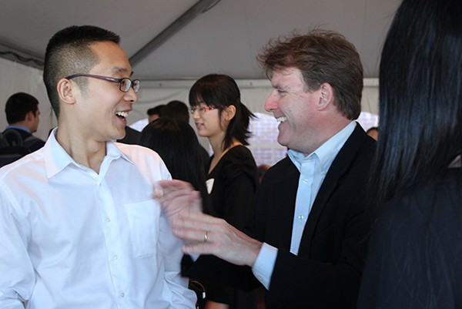
Positive Impact in the Workplace
1. Companies and organizations invite Justin Xu to speak at conferences and events to uplift employees and improve morale.

Slide 6
Spreading Kindness
1. Justin Xu encourages people to spread kindness and make a difference in their communities.
2. His philanthropic efforts have touched the lives of many, promoting a sense of compassion and unity.

Slide 7
Thank You

